Slide 1

Gradient Descent for Logistic Regression
Presented by:
Elizer Ponio Jr.
Department of Computer Science
College of Computing and Information Technologies

Slide 2
Outline
What is Logistic Regression?
Comparing Linear and Logistic Regression

Slide 3
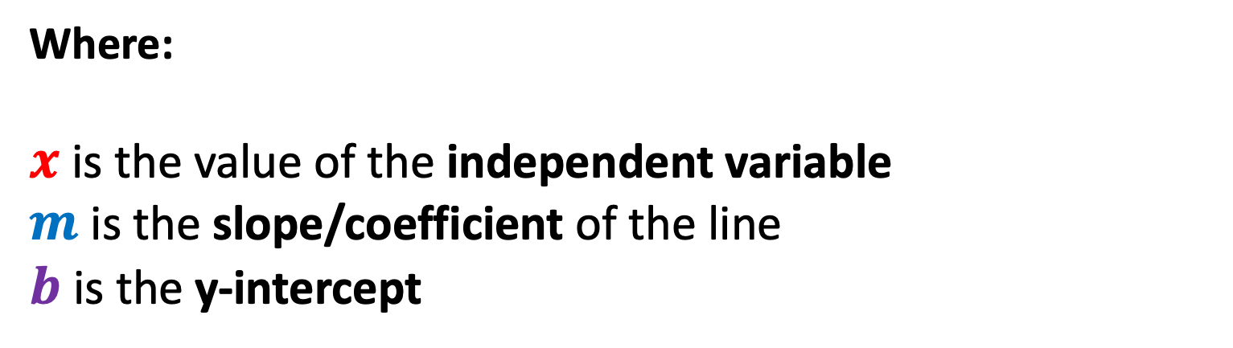
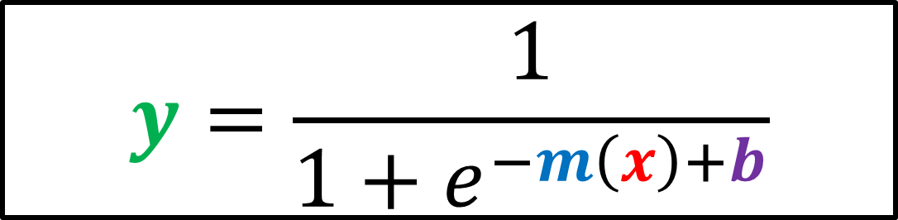
Logistic/Sigmoid Function
$$y=\frac{1}{1+e^{−m\left(x\right)+b}}$$
Where:
$x$ is the value of the independent variable
$m$ is the slope/coefficient of the line
$b$ is the y-intercept

Slide 4
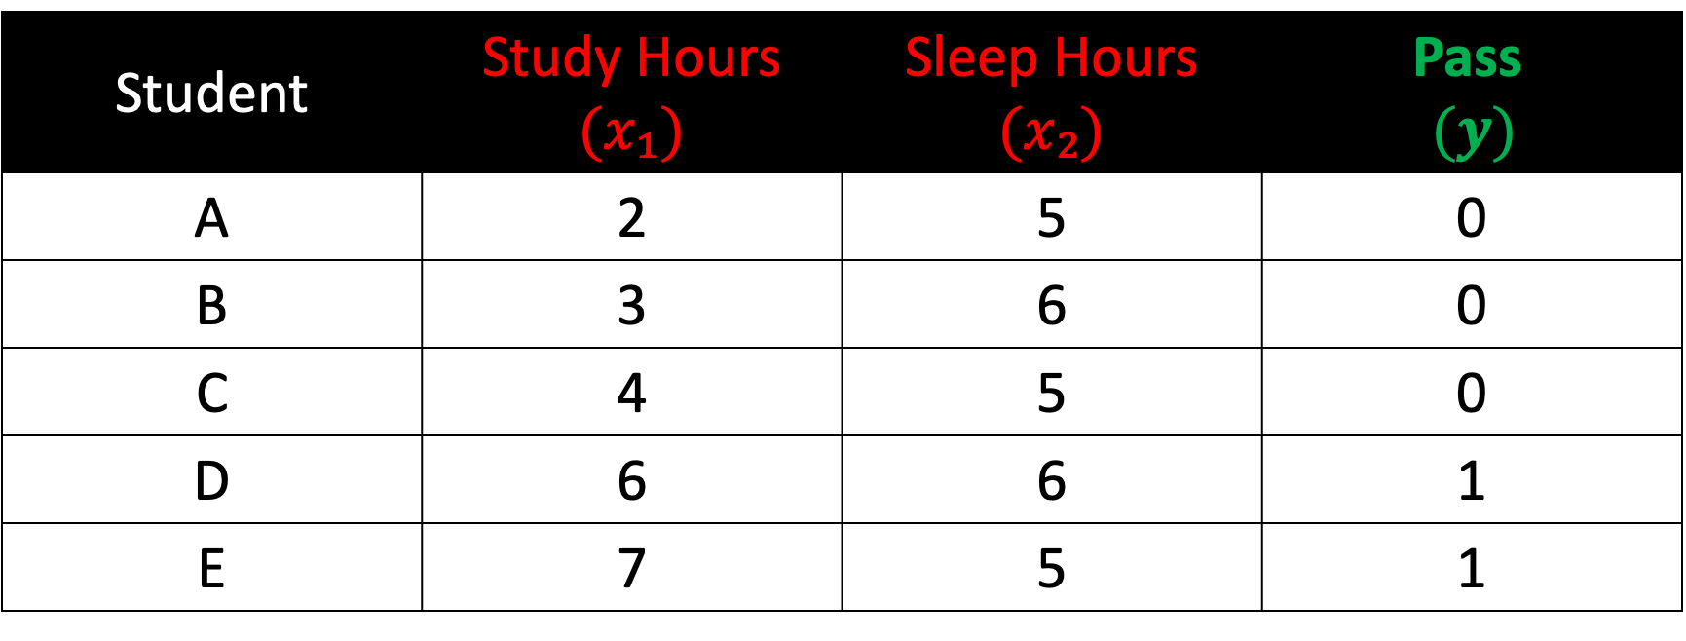
Example: Predicting if a Student will Pass or fail
Student | Study Hours $(x₁)$ | Sleep Hours $(x₂)$ | Pass $$(y)$$
A | 2 | 5 | 0
B | 3 | 6 | 0
C | 4 | 5 | 0
D | 6 | 6 | 1
E | 7 | 5 | 1

Slide 5
Step 1:
Initialize slope and intercept

Slide 6
$$y=\frac{1}{1+e^{−m\left(x\right)+b}}$$
Because we now have two independent variables, we need to extend this equation

Slide 7
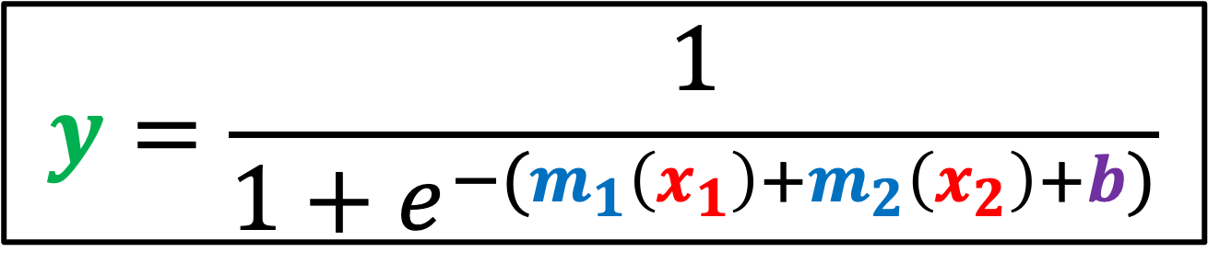
$$y=\frac{1}{1+e^{−(m_{1}\left(x_{1}\right)+m_{2}\left(x_{2}\right)+b)}}$$
Because we now have two independent variables, we need to extend this equation

Slide 8
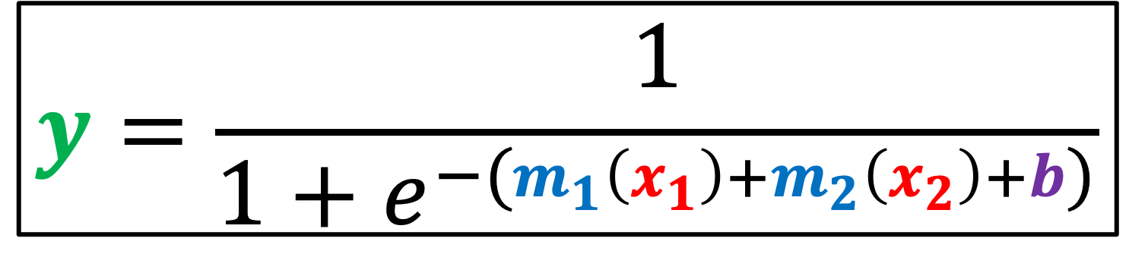
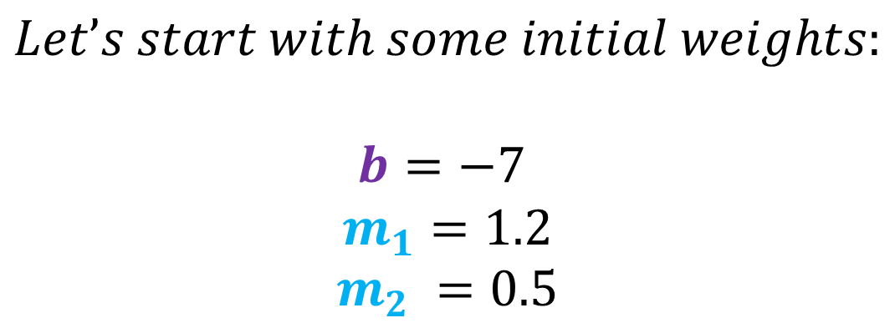
$$y=\frac{1}{1+e^{−(m_{1}\left(x_{1}\right)+m_{2}\left(x_{2}\right)+b)}}$$
$$Let’s start with some initial weights:$$
$$b=−7$$
$$m_{1}=1.2$$
$$m_{2} =0.5$$

Slide 9
Step 2:
Compute probabilities

Slide 10
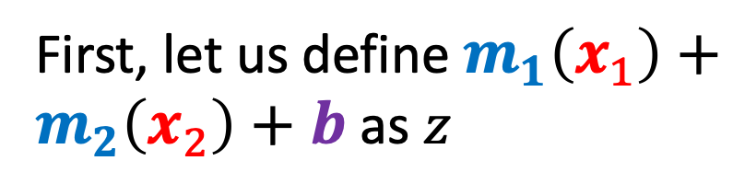
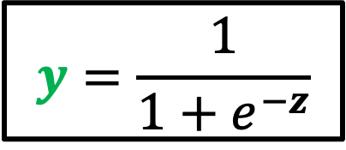
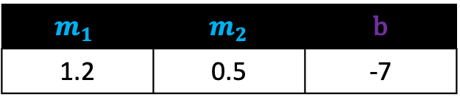
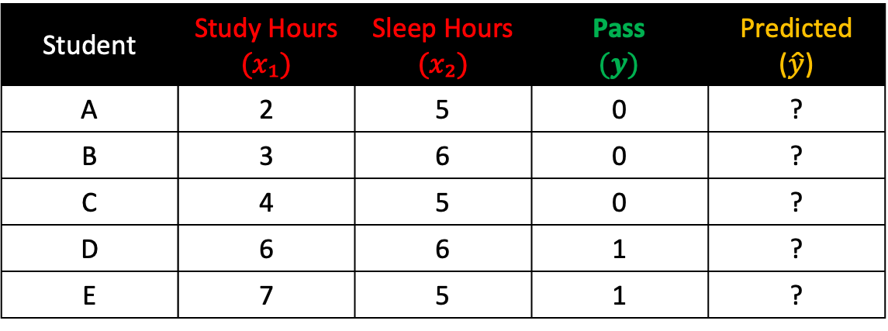
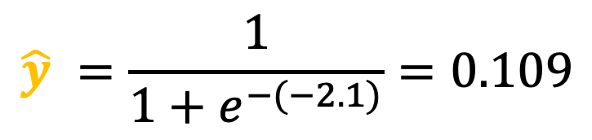
Compute the probability of Student A
First, let us define $m_{1}\left(x_{1}\right)+m_{2}\left(x_{2}\right)+b$ as $z$
Student | Study Hours $(x₁)$ | Sleep Hours $(x₂)$ | Pass $$(y)$$ | Predicted ($\hat{y}$)
A | 2 | 5 | 0 | ?
B | 3 | 6 | 0 | ?
C | 4 | 5 | 0 | ?
D | 6 | 6 | 1 | ?
E | 7 | 5 | 1 | ?
$$z=1.2\left(2\right)+0.5\left(5\right)+\left(−7\right)=−2.1$$
$$m_{1}$$ | $m_{2}$ | b
1.2 | 0.5 | -7
1
$$y=\frac{1}{1+e^{−z}}$$
2
$$\hat{y} ​=\frac{1}{{1+e}^{−(−2.1)}}=0.109$$
3

Slide 11
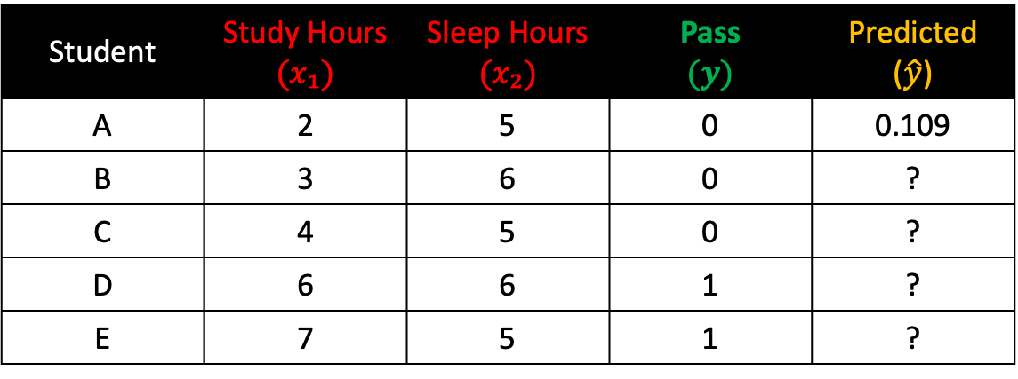

Compute the probability of Student B
First, let us define $m_{1}\left(x_{1}\right)+m_{2}\left(x_{2}\right)+b$ as $z$
Student | Study Hours $(x₁)$ | Sleep Hours $(x₂)$ | Pass $$(y)$$ | Predicted ($\hat{y}$)
A | 2 | 5 | 0 | 0.109
B | 3 | 6 | 0 | ?
C | 4 | 5 | 0 | ?
D | 6 | 6 | 1 | ?
E | 7 | 5 | 1 | ?
$$z=1.2\left(3\right)+0.5\left(6\right)+\left(−7\right)=−0.4$$
$$m_{1}$$ | $m_{2}$ | b
1.2 | 0.5 | -7
1
$$y=\frac{1}{1+e^{−z}}$$
2
$$\hat{y} ​=\frac{1}{{1+e}^{−(−0.4)}}=0.401$$
3

Slide 12
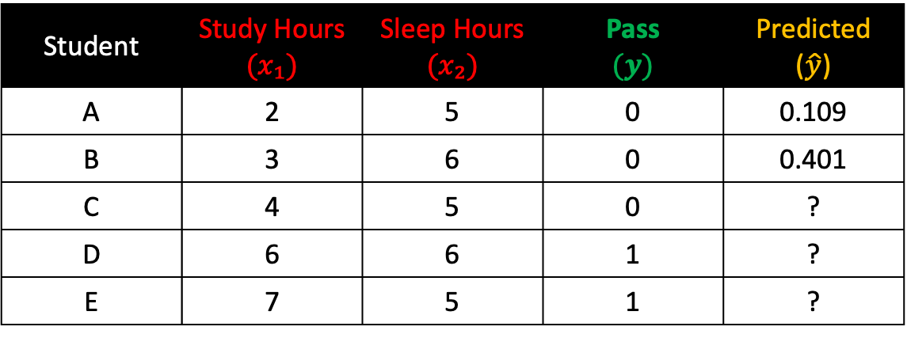
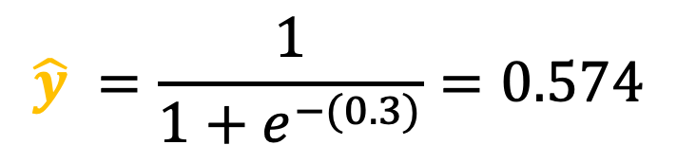
Compute the probability of Student C
First, let us define $m_{1}\left(x_{1}\right)+m_{2}\left(x_{2}\right)+b$ as $z$
Student | Study Hours $(x₁)$ | Sleep Hours $(x₂)$ | Pass $$(y)$$ | Predicted ($\hat{y}$)
A | 2 | 5 | 0 | 0.109
B | 3 | 6 | 0 | 0.401
C | 4 | 5 | 0 | ?
D | 6 | 6 | 1 | ?
E | 7 | 5 | 1 | ?
$$z=1.2\left(4\right)+0.5\left(5\right)+\left(−7\right)=0.3$$
$$m_{1}$$ | $m_{2}$ | b
1.2 | 0.5 | -7
1
$$y=\frac{1}{1+e^{−z}}$$
2
$$\hat{y} ​=\frac{1}{{1+e}^{−(0.3)}}=0.574$$
3

Slide 13


Compute the probability of Student D
First, let us define $m_{1}\left(x_{1}\right)+m_{2}\left(x_{2}\right)+b$ as $z$
Student | Study Hours $(x₁)$ | Sleep Hours $(x₂)$ | Pass $$(y)$$ | Predicted ($\hat{y}$)
A | 2 | 5 | 0 | 0.109
B | 3 | 6 | 0 | 0.401
C | 4 | 5 | 0 | 0.574
D | 6 | 6 | 1 | ?
E | 7 | 5 | 1 | ?
$$z=1.2\left(6\right)+0.5\left(6\right)+\left(−7\right)=3.2$$
$$m_{1}$$ | $m_{2}$ | b
1.2 | 0.5 | -7
1
$$y=\frac{1}{1+e^{−z}}$$
2
$$\hat{y} ​=\frac{1}{{1+e}^{−(3.2)}}=0.961$$
3

Slide 14
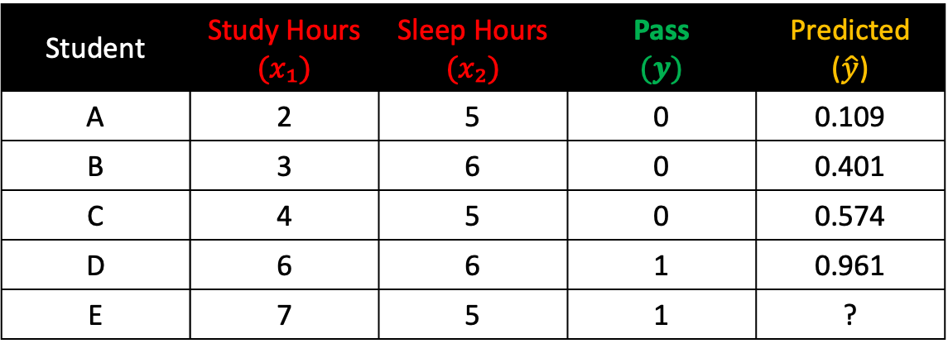

Compute the probability of Student E
First, let us define $m_{1}\left(x_{1}\right)+m_{2}\left(x_{2}\right)+b$ as $z$
Student | Study Hours $(x₁)$ | Sleep Hours $(x₂)$ | Pass $$(y)$$ | Predicted ($\hat{y}$)
A | 2 | 5 | 0 | 0.109
B | 3 | 6 | 0 | 0.401
C | 4 | 5 | 0 | 0.574
D | 6 | 6 | 1 | 0.961
E | 7 | 5 | 1 | ?
$$z=1.2\left(7\right)+0.5\left(5\right)+\left(−7\right)=3.9$$
$$m_{1}$$ | $m_{2}$ | b
1.2 | 0.5 | -7
1
$$y=\frac{1}{1+e^{−z}}$$
2
$$\hat{y} ​=\frac{1}{{1+e}^{−(3.9)}}=0.980$$
3

Slide 15
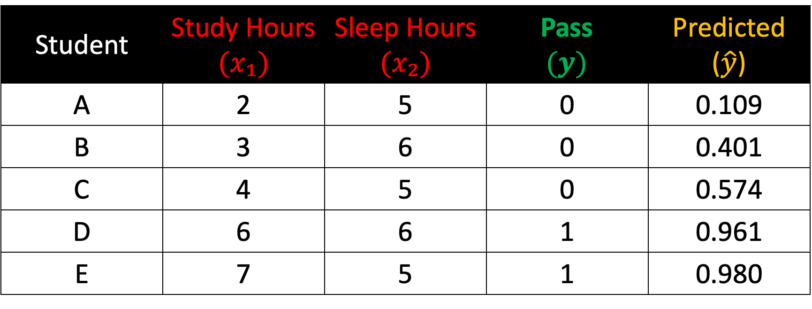
Prediction Results
Student | Study Hours $(x₁)$ | Sleep Hours $(x₂)$ | Pass $$(y)$$ | Predicted ($\hat{y}$)
A | 2 | 5 | 0 | 0.109
B | 3 | 6 | 0 | 0.401
C | 4 | 5 | 0 | 0.574
D | 6 | 6 | 1 | 0.961
E | 7 | 5 | 1 | 0.980

Slide 16
Step 3:
Compute Loss

Slide 17
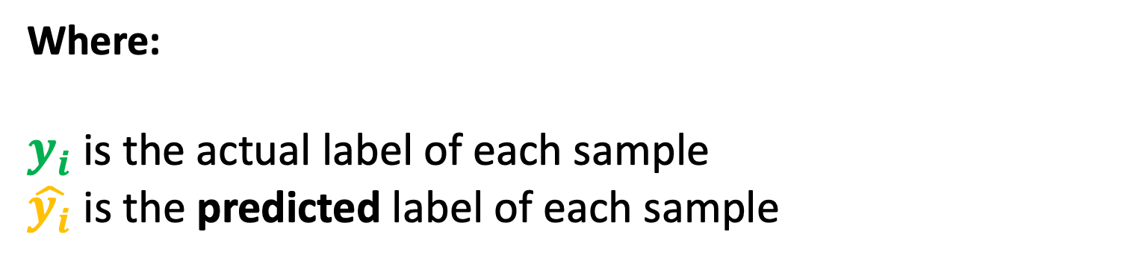
Computing Loss (Binary Cross-Entropy)
$${loss}_{i}=−(y_{i} × \ln{(\hat{y_{i}})}+\left(1−y_{i}\right) × ln⁡(1−\hat{y_{i}}))$$
Where:
$y_{i}$ is the actual label of each sample
$\hat{y_{i}}$is the predicted label of each sample

Slide 18

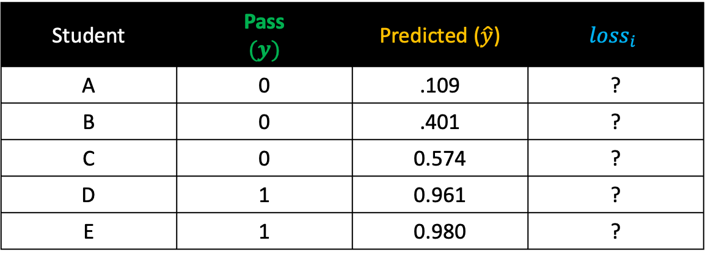


Compute the loss of Student A
Student | Pass $$(y)$$ | Predicted ($\hat{y}$) | $${loss}_{i}$$
A | 0 | .109 | ?
B | 0 | .401 | ?
C | 0 | 0.574 | ?
D | 1 | 0.961 | ?
E | 1 | 0.980 | ?
$${loss}_{i}=−(y_{i} × \ln{(\hat{y_{i}})}+\left(1−y_{i}\right) × ln⁡(1−\hat{y_{i}}))$$
1
$${loss}_{i}=−(0 × ln⁡(0.109)+\left(1−0\right) × ln⁡(1−0.109))$$
2
$${loss}_{i}=−(0+1 × ln⁡(1−0.109))$$
3
$${loss}_{i}=−(ln\left(1−0.109)\right)$$
4
$${loss}_{i}=−\ln\left(0.8909\right)=0.1155$$

Slide 19

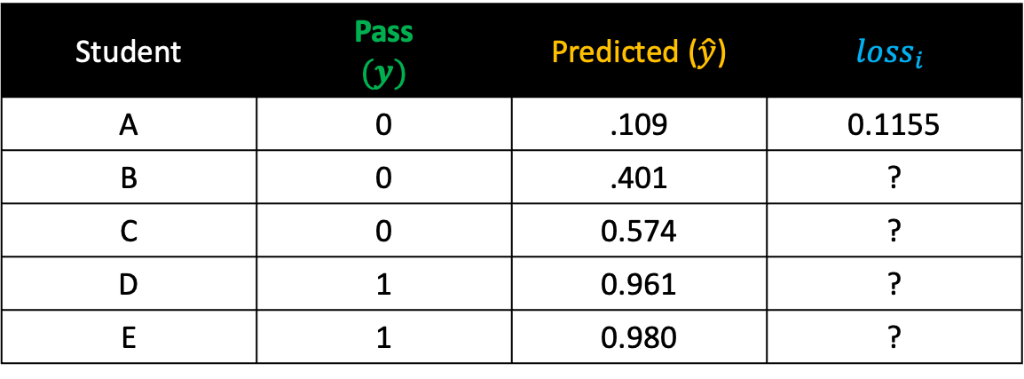


Compute the loss of Student B
Student | Pass $$(y)$$ | Predicted ($\hat{y}$) | $${loss}_{i}$$
A | 0 | .109 | 0.1155
B | 0 | .401 | ?
C | 0 | 0.574 | ?
D | 1 | 0.961 | ?
E | 1 | 0.980 | ?
$${loss}_{i}=−(y_{i} × \ln{(\hat{y_{i}})}+\left(1−y_{i}\right) × ln⁡(1−\hat{y_{i}}))$$
1
$${loss}_{i}=−(0 × ln⁡(0.401)+\left(1−0\right) × ln⁡(1−0.401))$$
2
$${loss}_{i}=−(0+1 × ln⁡(1−0.401))$$
3
$${loss}_{i}=−\ln\left(1−0.401\right)$$
4
$${loss}_{i}=−\ln\left(0.5987\right)=0.5130$$

Slide 20




Compute the loss of Student C
Student | Pass $$(y)$$ | Predicted ($\hat{y}$) | $${loss}_{i}$$
A | 0 | .109 | 0.1155
B | 0 | .401 | 0.5130
C | 0 | 0.574 | ?
D | 1 | 0.961 | ?
E | 1 | 0.980 | ?
$${loss}_{i}=−(y_{i} × \ln{(\hat{y_{i}})}+\left(1−y_{i}\right) × ln⁡(1−\hat{y_{i}}))$$
1
$${loss}_{i}=−(0 × ln⁡(0.574)+\left(1−0\right) × ln⁡(1−0.574))$$
2
$${loss}_{i}=−(0+1 × ln⁡(1−0.574))$$
3
$${loss}_{i}=−\ln\left(1−0.574\right)$$
4
$${loss}_{i}=−\ln\left(0.4256\right)=0.8544$$

Slide 21
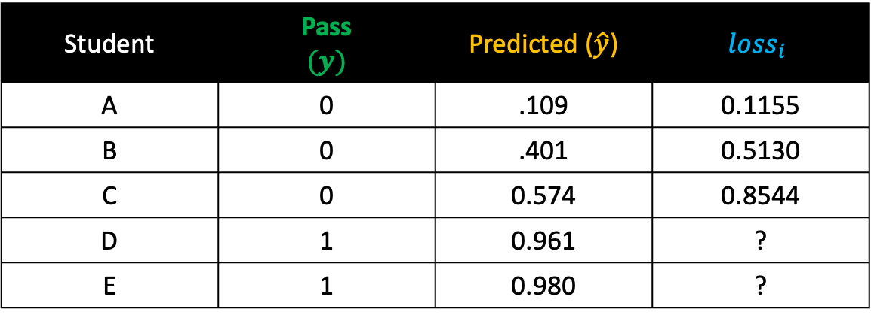


Compute the loss of Student D
Student | Pass $$(y)$$ | Predicted ($\hat{y}$) | $${loss}_{i}$$
A | 0 | .109 | 0.1155
B | 0 | .401 | 0.5130
C | 0 | 0.574 | 0.8544
D | 1 | 0.961 | ?
E | 1 | 0.980 | ?
$${loss}_{i}=−(y_{i} × \ln{(\hat{y_{i}})}+\left(1−y_{i}\right) × ln⁡(1−\hat{y_{i}}))$$
1
$${loss}_{i}=−(1 × ln⁡(0.961)+\left(1−1\right) × ln⁡(1−0.961))$$
2
${loss}_{i}=−\left(\ln\left(0.961\right)+0 × ln⁡(1−0.961)\right)$
3
$${loss}_{i}=−\ln\left(0.961\right)$$
4
$${loss}_{i}=0.0396$$

Slide 22
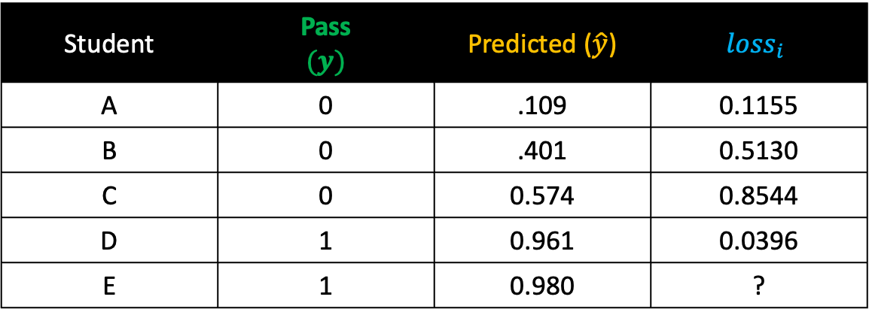


Compute the loss of Student E
Student | Pass $$(y)$$ | Predicted ($\hat{y}$) | $${loss}_{i}$$
A | 0 | .109 | 0.1155
B | 0 | .401 | 0.5130
C | 0 | 0.574 | 0.8544
D | 1 | 0.961 | 0.0396
E | 1 | 0.980 | ?
$${loss}_{i}=−(y_{i} × \ln{(\hat{y_{i}})}+\left(1−y_{i}\right) × ln⁡(1−\hat{y_{i}}))$$
1
$${loss}_{i}=−(1 × ln⁡(0.980)+\left(1−1\right) × ln⁡(1−0.980))$$
2
$${loss}_{i}=−(\ln\left(0.980\right)+0 × ln⁡(1−0.980))$$
3
$${loss}_{i}=−\ln\left(0.980\right)$$
4
$${loss}_{i}=0.02004$$

Slide 23
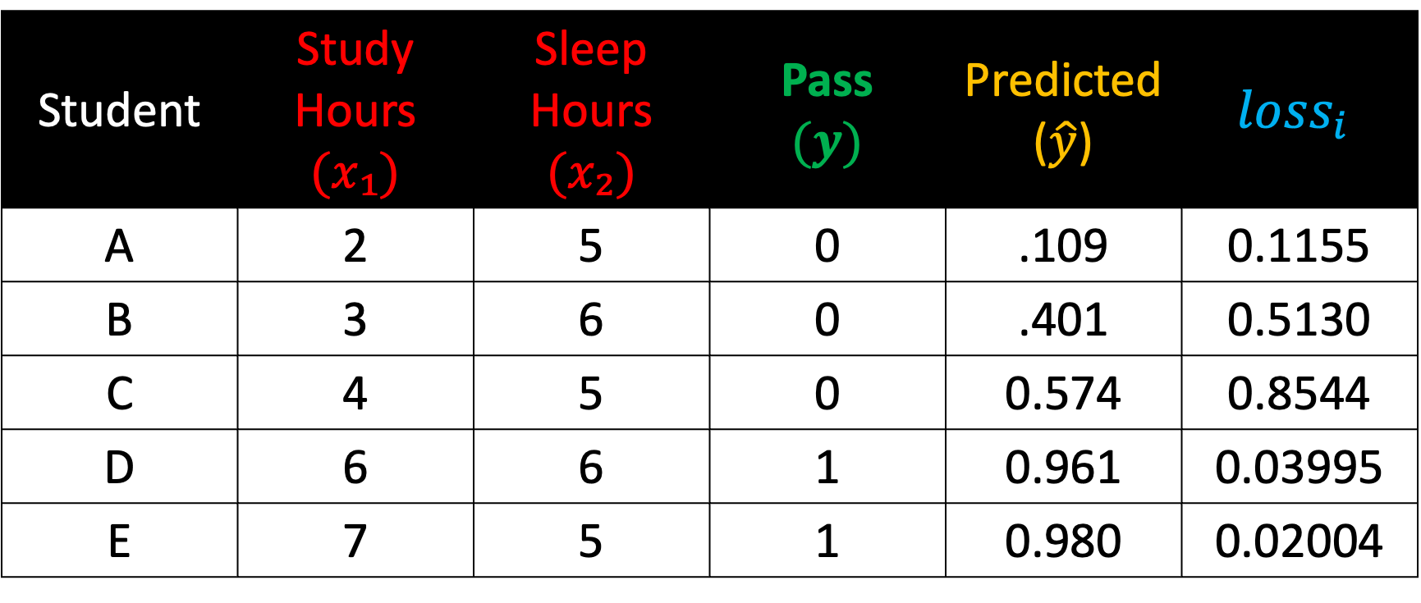
Computing Loss (Binary Cross-Entropy)
Student | Study Hours $(x₁)$ | Sleep Hours $(x₂)$ | Pass $$(y)$$ | Predicted ($\hat{y}$) | $${loss}_{i}$$
A | 2 | 5 | 0 | .109 | 0.1155
B | 3 | 6 | 0 | .401 | 0.5130
C | 4 | 5 | 0 | 0.574 | 0.8544
D | 6 | 6 | 1 | 0.961 | 0.03995
E | 7 | 5 | 1 | 0.980 | 0.02004

Slide 24
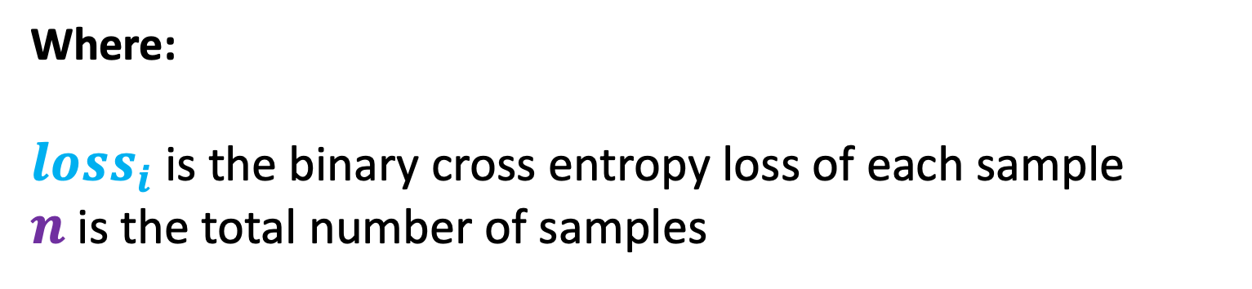
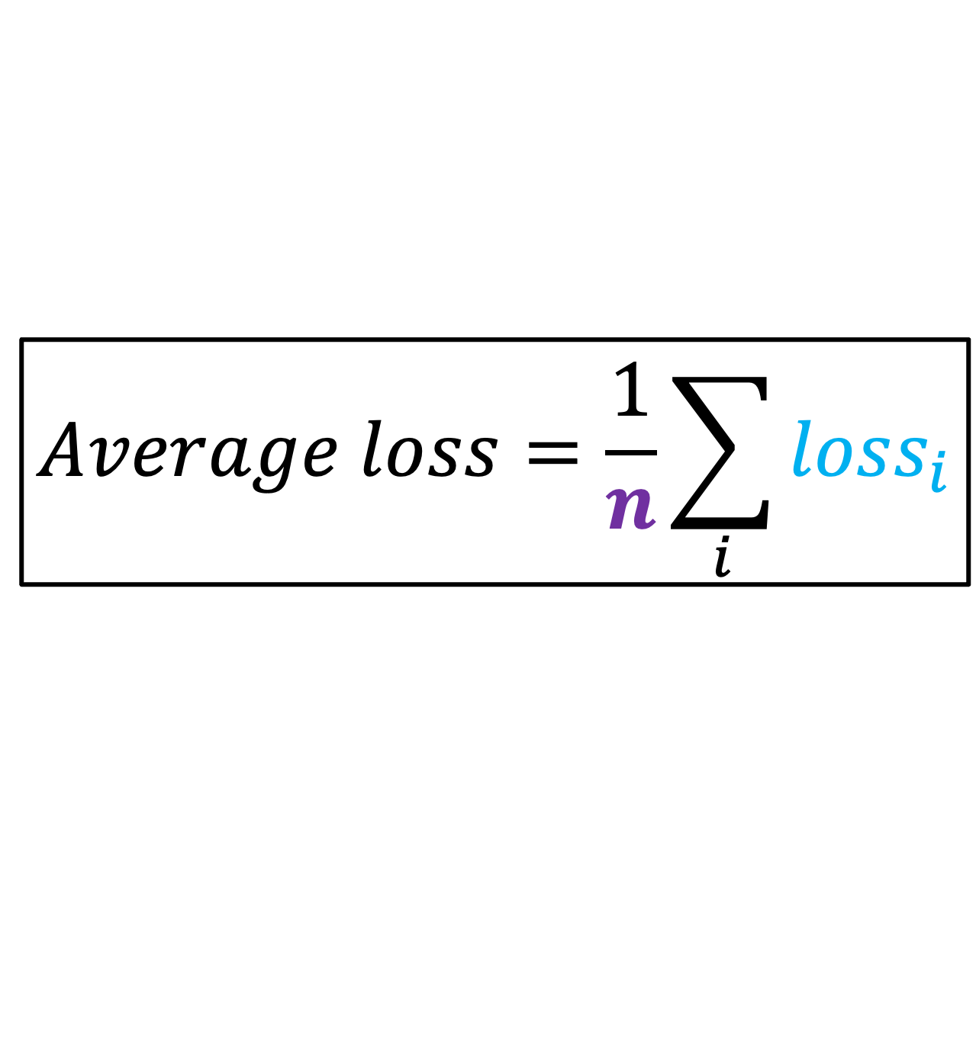
Compute the Average Loss
$$Average loss=\frac{1}{n}\sum_{i}{{loss}_{i}}$$
Where:
${loss}_{i}$ is the binary cross entropy loss of each sample
$n$is the total number of samples

Slide 25
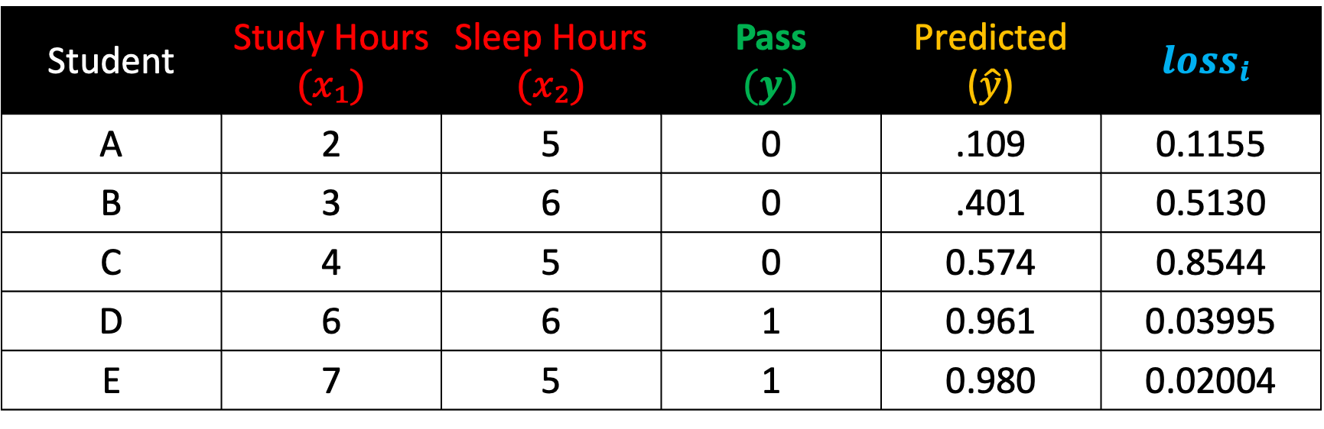
Compute the Average Loss
Student | Study Hours $(x₁)$ | Sleep Hours $(x₂)$ | Pass $$(y)$$ | Predicted ($\hat{y}$) | $${loss}_{i}$$
A | 2 | 5 | 0 | .109 | 0.1155
B | 3 | 6 | 0 | .401 | 0.5130
C | 4 | 5 | 0 | 0.574 | 0.8544
D | 6 | 6 | 1 | 0.961 | 0.03995
E | 7 | 5 | 1 | 0.980 | 0.02004
$$Average loss=\frac{0.1155+0.5130+0.8544+0.03995+0.02004​}{5}=\frac{1.54​}{5}=0.3086$$

Slide 26
Step 5:
Find the optimal slope and intercept

Slide 27
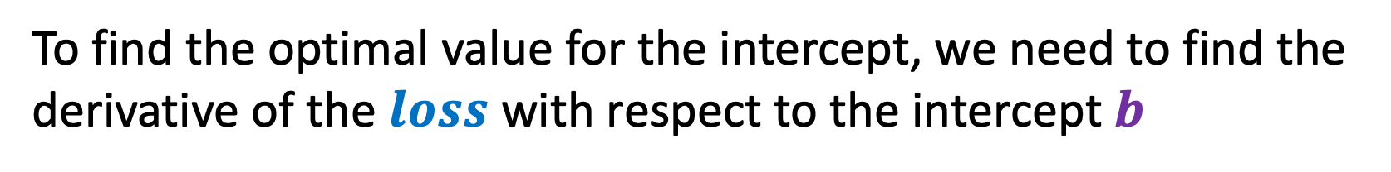

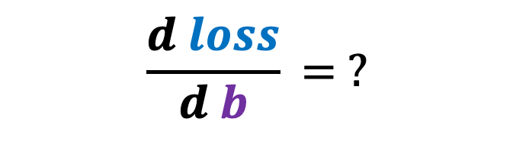
Find the derivative of loss w.r.t. to intercept $b$
$$\frac{d loss}{d b}​= ?$$
To find the optimal value for the intercept, we need to find the derivative of the $loss$ with respect to the intercept $b$

Slide 28

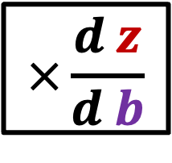

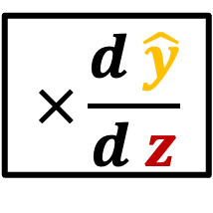
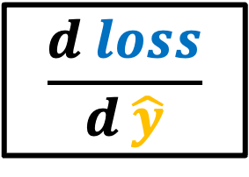
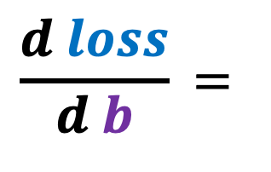
Find the derivative of loss w.r.t. to intercept $b$
$$\frac{d loss}{d b}​=$$
$$\frac{d loss}{d \hat{y}}$$
$$×\frac{d \hat{y}}{d z}$$
$$×\frac{d z}{d b}$$
The chain-rule states that the derivative of the $loss$ with respect to the intercept $b$is the product of these derivatives

Slide 29
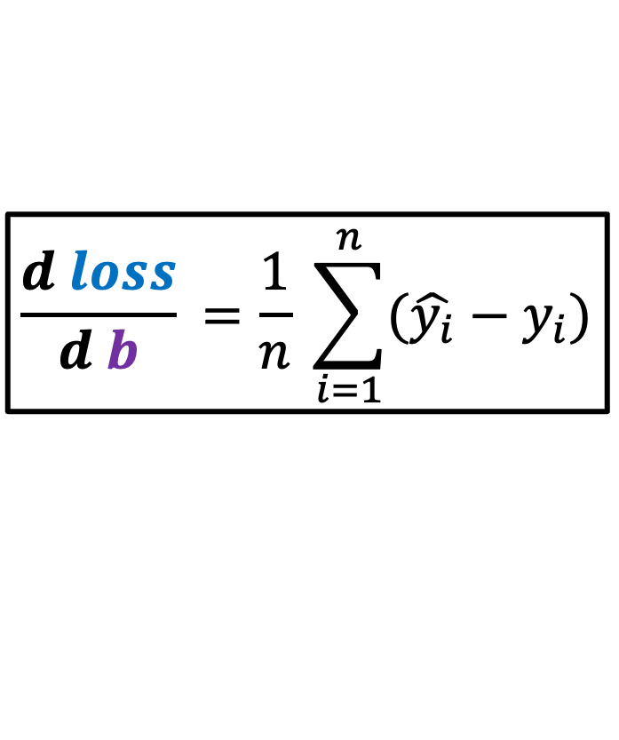
Find the derivative of loss w.r.t. to intercept $b$
$$\frac{d loss}{d b}​=\frac{1}{n} \sum_{i=1}^{n}{(\hat{y_{i}}−y_{i})}$$
Giving us this equation

Slide 30
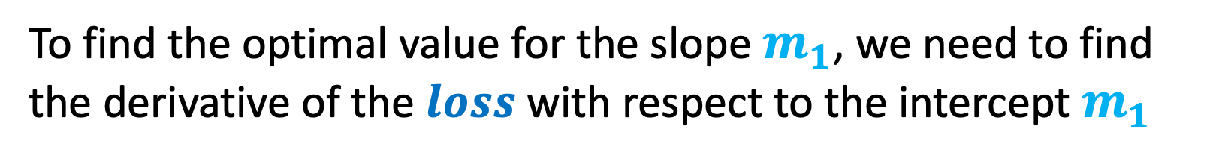

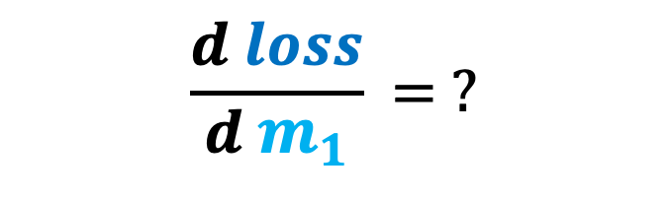
Find the derivative of loss w.r.t. to slope${ m}_{1}$
$$\frac{d loss}{d{ m}_{1}}​= ?$$
To find the optimal value for the slope $m_{1}$, we need to find the derivative of the $loss$ with respect to the intercept${ m}_{1}$

Slide 31

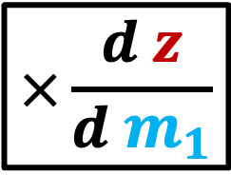
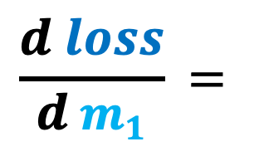
Find the derivative of loss w.r.t. to slope${ m}_{1}$
$$\frac{d loss}{d{ m}_{1}}​=$$
$$\frac{d loss}{d \hat{y}}$$
$$×\frac{d \hat{y}}{d z}$$
$$×\frac{d z}{d{ m}_{1}}$$
The chain-rule states that the derivative of the $loss$ with respect to the slope${ m}_{1}$is the product of these derivatives

Slide 32
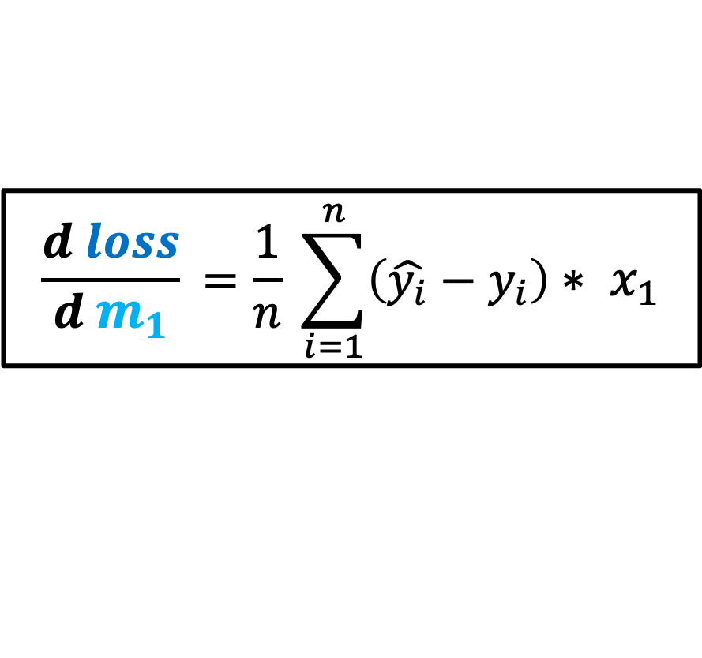
Find the derivative of loss w.r.t. to slope${ m}_{1}$
$$\frac{d loss}{d m_{1}}​=\frac{1}{n} \sum_{i=1}^{n}{\left(\hat{y_{i}}−y_{i}\right)∗ x_{1}}$$
Giving us this equation

Slide 33
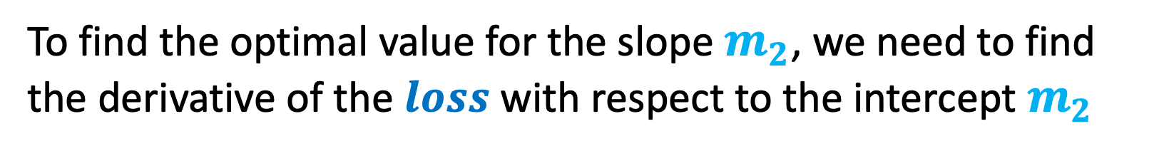


Find the derivative of loss w.r.t. to slope${ m}_{2}$
$$\frac{d loss}{d{ m}_{2}}​= ?$$
To find the optimal value for the slope $m_{2}$, we need to find the derivative of the $loss$ with respect to the intercept${ m}_{2}$

Slide 34

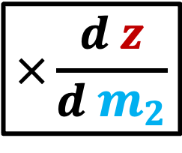

Find the derivative of loss w.r.t. to slope${ m}_{2}$
$$\frac{d loss}{d{ m}_{2}}​=$$
$$\frac{d loss}{d \hat{y}}$$
$$×\frac{d \hat{y}}{d z}$$
$$×\frac{d z}{d{ m}_{2}}$$
The chain-rule states that the derivative of the $loss$ with respect to the slope${ m}_{2}$is the product of these derivatives

Slide 35

Find the derivative of loss w.r.t. to slope${ m}_{2}$
$$\frac{d loss}{d m_{2}}​=\frac{1}{n} \sum_{i=1}^{n}{\left(\hat{y_{i}}−y_{i}\right)∗ x_{2}}$$
Giving us this equation

Slide 36
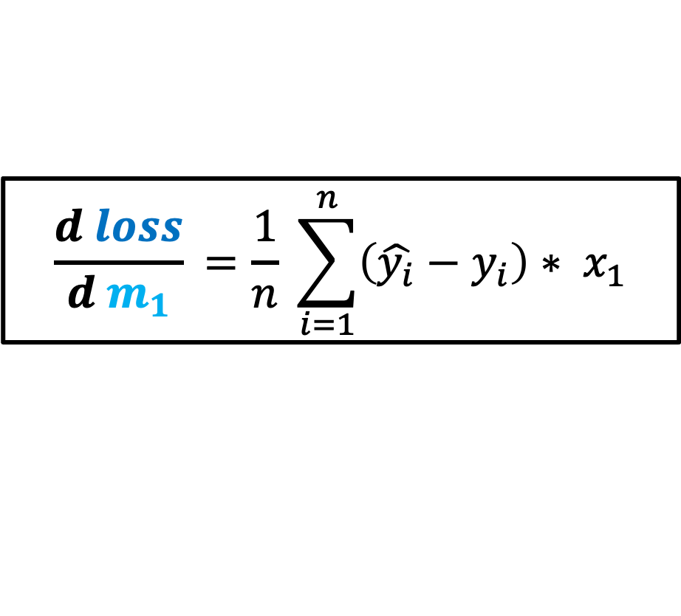
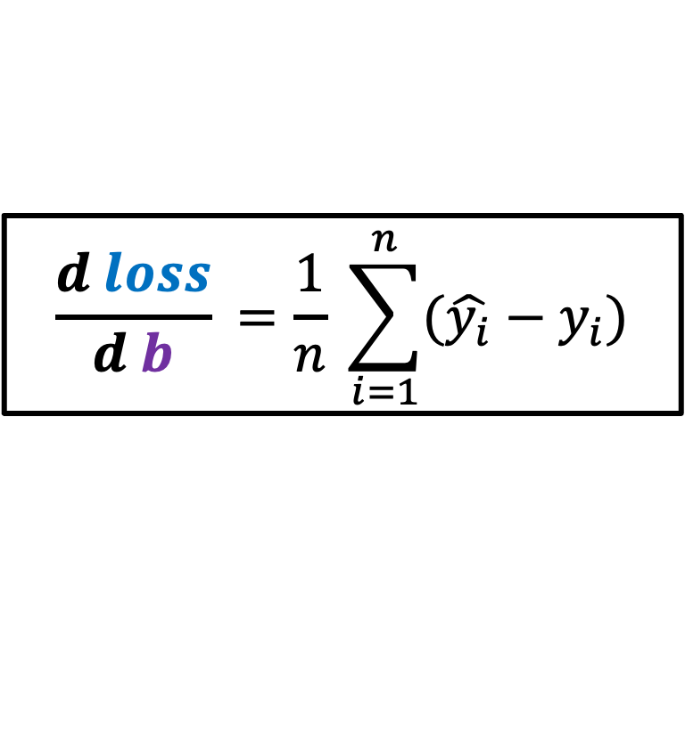


Derivatives for Gradient Descent
$$\frac{d loss}{d b}​=\frac{1}{n} \sum_{i=1}^{n}{(\hat{y_{i}}−y_{i})}$$
$$\frac{d loss}{d m_{1}}​=\frac{1}{n} \sum_{i=1}^{n}{\left(\hat{y_{i}}−y_{i}\right)∗ x_{1}}$$
$$\frac{d loss}{d m_{2}}​=\frac{1}{n} \sum_{i=1}^{n}{\left(\hat{y_{i}}−y_{i}\right)∗ x_{2}}$$
We now have the derivatives for loss $b$ with respect to intercept and loss with respect to the slopes $m_{1}$and $m_{2}$

Slide 37
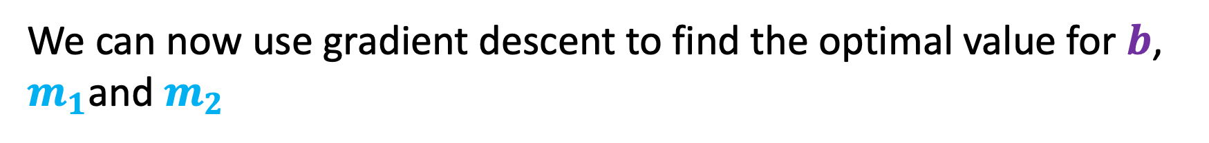
Derivatives for Gradient Descent
$$\frac{d loss}{d b}​=\frac{1}{n} \sum_{i=1}^{n}{(\hat{y_{i}}−y_{i})}$$
$$\frac{d loss}{d m_{1}}​=\frac{1}{n} \sum_{i=1}^{n}{\left(\hat{y_{i}}−y_{i}\right)∗ x_{1}}$$
$$\frac{d loss}{d m_{2}}​=\frac{1}{n} \sum_{i=1}^{n}{\left(\hat{y_{i}}−y_{i}\right)∗ x_{2}}$$
We can now use gradient descent to find the optimal value for $b$, $m_{1}$and $m_{2}$

Slide 38
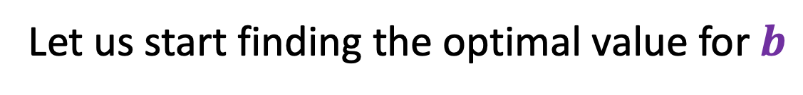
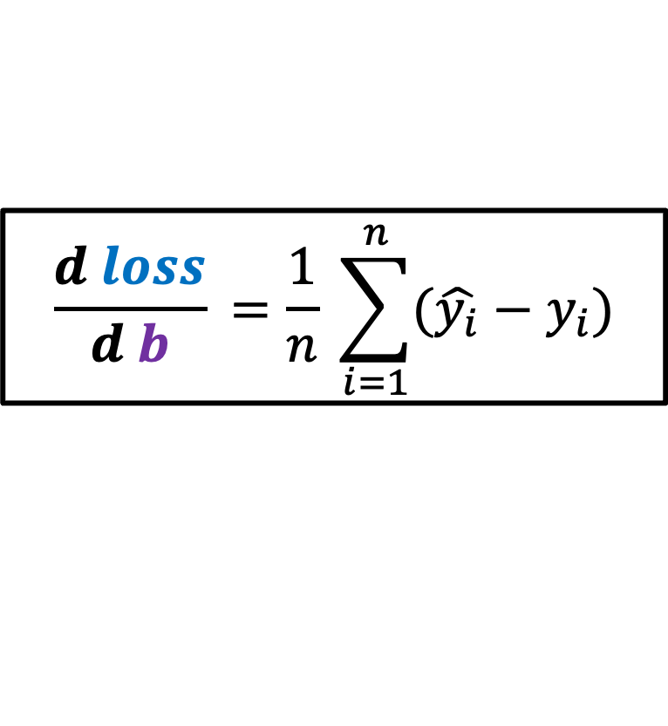
Computing the Gradients
$$\frac{d loss}{d b}​=\frac{1}{n} \sum_{i=1}^{n}{(\hat{y_{i}}−y_{i})}$$
Let us start finding the optimal value for $b$

Slide 39

Computing the Gradients
$$\frac{d loss}{d b}​=\frac{1}{n} \sum_{i=1}^{n}{(\hat{y_{i}}−y_{i})}$$
According to the formula, to find the optimal value for $b$, we must get the difference of $\hat{y_{i}}$ and $y_{i}$ and get the average.

Slide 40
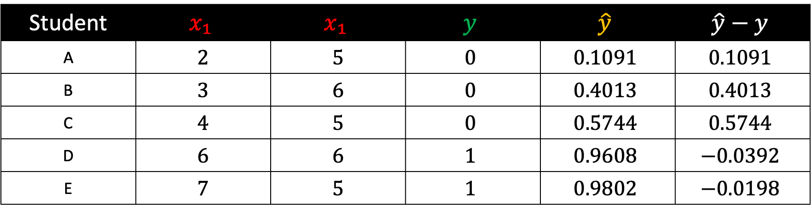
Computing the Gradients
Student | $$x₁$$ | $$x₁$$ | $$y$$ | $$\hat{y}$$ | $$\hat{y}−y$$
A | 2 | 5 | $$0$$ | $$0.1091$$ | $$0.1091$$
B | 3 | 6 | $$0$$ | $$0.4013$$ | $$0.4013$$
C | 4 | 5 | $$0$$ | $$0.5744$$ | $$0.5744$$
D | 6 | 6 | $$1$$ | $$0.9608$$ | $$−0.0392$$
E | 7 | 5 | $$1$$ | $$0.9802$$ | $$−0.0198$$
First, we must get the difference of $\hat{y_{i}}$ and $y_{i}$ for each row.

Slide 41
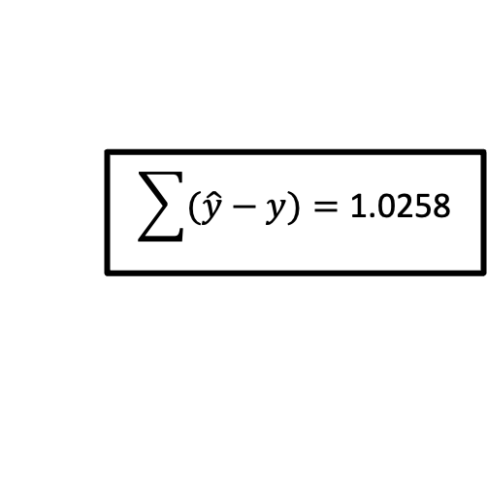
Computing the Gradients
Student | $$x₁$$ | $$x₁$$ | $$y$$ | $$\hat{y}$$ | $$\hat{y}−y$$
A | 2 | 5 | $$0$$ | $$0.1091$$ | $$0.1091$$
B | 3 | 6 | $$0$$ | $$0.4013$$ | $$0.4013$$
C | 4 | 5 | $$0$$ | $$0.5744$$ | $$0.5744$$
D | 6 | 6 | $$1$$ | $$0.9608$$ | $$−0.0392$$
E | 7 | 5 | $$1$$ | $$0.9802$$ | $$−0.0198$$
$$\sum{(\hat{y}−y)}=\text{1.0258}$$
Get the sum

Slide 42
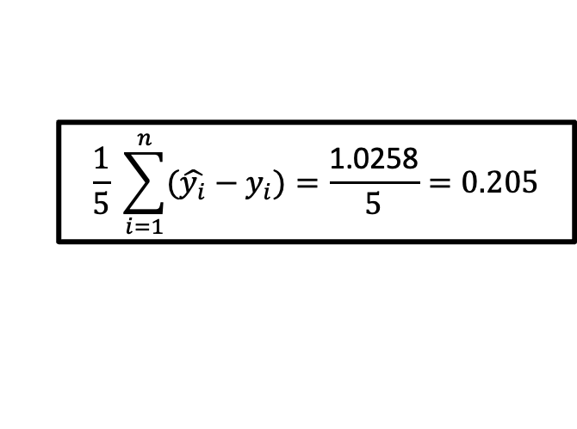
Computing the Gradients
Student | $$x₁$$ | $$x₁$$ | $$y$$ | $$\hat{y}$$ | $$\hat{y}−y$$
A | 2 | 5 | $$0$$ | $$0.1091$$ | $$0.1091$$
B | 3 | 6 | $$0$$ | $$0.4013$$ | $$0.4013$$
C | 4 | 5 | $$0$$ | $$0.5744$$ | $$0.5744$$
D | 6 | 6 | $$1$$ | $$0.9608$$ | $$−0.0392$$
E | 7 | 5 | $$1$$ | $$0.9802$$ | $$−0.0198$$
$$\frac{1}{5} \sum_{i=1}^{n}{(\hat{y_{i}}−y_{i})}=\frac{\text{1.0258}}{5}=0.205$$
And get the average

Slide 43
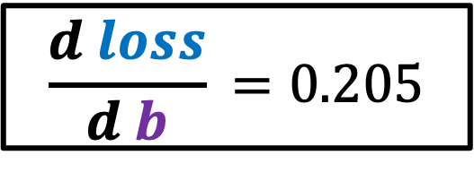
Computing the Gradients
Student | $$x₁$$ | $$x₁$$ | $$y$$ | $$\hat{y}$$ | $$\hat{y}−y$$
A | 2 | 5 | $$0$$ | $$0.1091$$ | $$0.1091$$
B | 3 | 6 | $$0$$ | $$0.4013$$ | $$0.4013$$
C | 4 | 5 | $$0$$ | $$0.5744$$ | $$0.5744$$
D | 6 | 6 | $$1$$ | $$0.9608$$ | $$−0.0392$$
E | 7 | 5 | $$1$$ | $$0.9802$$ | $$−0.0198$$
$$\frac{d loss}{d b}​=0.205$$
Which gives us this gradient,

Slide 44

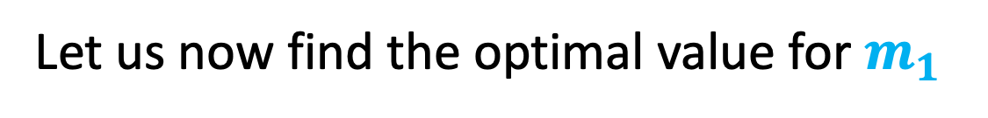
Computing the Gradients
$$\frac{d loss}{d m_{1}}​=\frac{1}{n} \sum_{i=1}^{n}{\left(\hat{y_{i}}−y_{i}\right)∗ x_{1}}$$
Let us now find the optimal value for$m_{1}$

Slide 45
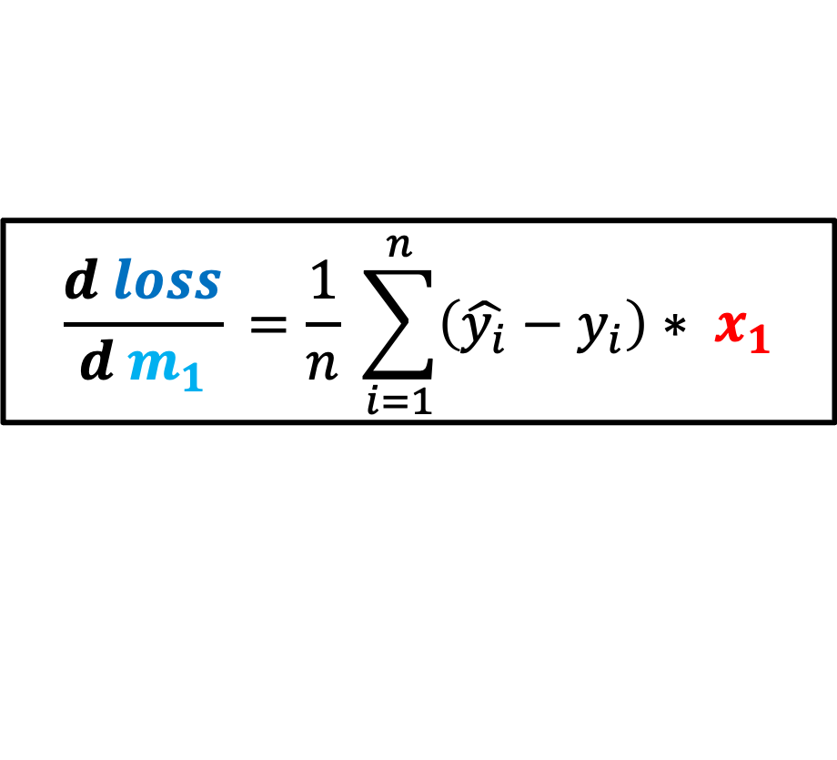

Computing the Gradients
$$\frac{d loss}{d m_{1}}​=\frac{1}{n} \sum_{i=1}^{n}{\left(\hat{y_{i}}−y_{i}\right)∗ x_{1}}$$
According to the formula, to find the optimal value for $b$, we must get the difference of $\hat{y_{i}}$ and $y_{i}$, multiply it with $x_{1}$and get the average.

Slide 46


Computing the Gradients
Student | $$x₁$$ | $$x_{2}$$ | $$y$$ | $$\hat{y}$$ | $$\hat{y}−y$$ | $$\left(\hat{y}−y\right)∗x₁$$
A | 2 | 5 | $$0$$ | $$0.1091$$ | $$0.1091$$ | 0.2182
B | 3 | 6 | $$0$$ | $$0.4013$$ | $$0.4013$$ | 1.2039
C | 4 | 5 | $$0$$ | $$0.5744$$ | $$0.5744$$ | 2.2976
D | 6 | 6 | $$1$$ | $$0.9608$$ | $$−0.0392$$ | -0.2352
E | 7 | 5 | $$1$$ | $$0.9802$$ | $$−0.0198$$ | -0.1386
$$\sum_{i=1}^{n}{\left(\hat{y_{i}}−y_{i}\right)∗ x_{1}}=\text{3.3459}$$
Get the sum

Slide 47

Computing the Gradients
Student | $$x₁$$ | $$x_{2}$$ | $$y$$ | $$\hat{y}$$ | $$\hat{y}−y$$ | $$\left(\hat{y}−y\right)∗x₁$$
A | 2 | 5 | $$0$$ | $$0.1091$$ | $$0.1091$$ | 0.2182
B | 3 | 6 | $$0$$ | $$0.4013$$ | $$0.4013$$ | 1.2039
C | 4 | 5 | $$0$$ | $$0.5744$$ | $$0.5744$$ | 2.2976
D | 6 | 6 | $$1$$ | $$0.9608$$ | $$−0.0392$$ | -0.2352
E | 7 | 5 | $$1$$ | $$0.9802$$ | $$−0.0198$$ | -0.1386
$$\frac{1}{n} \sum_{i=1}^{n}{\left(\hat{y_{i}}−y_{i}\right)∗ x_{1}}=\frac{\text{3.3459}}{5}=\text{0.6692}$$
Get the average

Slide 48

Computing the Gradients
Student | $$x₁$$ | $$x_{2}$$ | $$y$$ | $$\hat{y}$$ | $$\hat{y}−y$$ | $$\left(\hat{y}−y\right)∗x₁$$
A | 2 | 5 | $$0$$ | $$0.1091$$ | $$0.1091$$ | 0.2182
B | 3 | 6 | $$0$$ | $$0.4013$$ | $$0.4013$$ | 1.2039
C | 4 | 5 | $$0$$ | $$0.5744$$ | $$0.5744$$ | 2.2976
D | 6 | 6 | $$1$$ | $$0.9608$$ | $$−0.0392$$ | -0.2352
E | 7 | 5 | $$1$$ | $$0.9802$$ | $$−0.0198$$ | -0.1386
$$\frac{d loss}{d{ m}_{1}}​=0.6692$$
Which gives us this gradient,

Slide 49


Computing the Gradients
$$\frac{d loss}{d m_{2}}​=\frac{1}{n} \sum_{i=1}^{n}{\left(\hat{y_{i}}−y_{i}\right)∗ x_{1}}$$
Let us now find the optimal value for$m_{2}$

Slide 50


Computing the Gradients
$$\frac{d loss}{d m_{2}}​=\frac{1}{n} \sum_{i=1}^{n}{\left(\hat{y_{i}}−y_{i}\right)∗ x_{2}}$$
According to the formula, to find the optimal value for $b$, we must get the difference of $\hat{y_{i}}$ and $y_{i}$, multiply it with $x_{2}$and get the average.

Slide 51


Computing the Gradients
Student | $$x₁$$ | $$x_{2}$$ | $$y$$ | $$\hat{y}$$ | $$\hat{y}−y$$ | $$\left(\hat{y}−y\right)∗x₁$$ | $$\left(\hat{y}−y\right)∗ x_{2}$$
A | 2 | 5 | $$0$$ | $$0.1091$$ | $$0.1091$$ | 0.2182 | .5455
B | 3 | 6 | $$0$$ | $$0.4013$$ | $$0.4013$$ | 1.2039 | 2.4078
C | 4 | 5 | $$0$$ | $$0.5744$$ | $$0.5744$$ | 2.2976 | 2.872
D | 6 | 6 | $$1$$ | $$0.9608$$ | $$−0.0392$$ | -0.2352 | -0.2352
E | 7 | 5 | $$1$$ | $$0.9802$$ | $$−0.0198$$ | -0.1386 | -0.099
$$\sum{(\hat{y}−y)∗x_{2}}=\text{5.4911}$$
Get the sum

Slide 52

Computing the Gradients
Student | $$x₁$$ | $$x_{2}$$ | $$y$$ | $$\hat{y}$$ | $$\hat{y}−y$$ | $$\left(\hat{y}−y\right)∗x₁$$ | $$\left(\hat{y}−y\right)∗ x_{2}$$
A | 2 | 5 | $$0$$ | $$0.1091$$ | $$0.1091$$ | 0.2182 | .5455
B | 3 | 6 | $$0$$ | $$0.4013$$ | $$0.4013$$ | 1.2039 | 2.4078
C | 4 | 5 | $$0$$ | $$0.5744$$ | $$0.5744$$ | 2.2976 | 2.872
D | 6 | 6 | $$1$$ | $$0.9608$$ | $$−0.0392$$ | -0.2352 | -0.2352
E | 7 | 5 | $$1$$ | $$0.9802$$ | $$−0.0198$$ | -0.1386 | -0.099
$$\frac{1}{n} \sum_{i=1}^{n}{\left(\hat{y_{i}}−y_{i}\right)∗ x_{2}}=\frac{\text{5.49}11}{5}=\text{1.09822}$$
Get the average

Slide 53

Computing the Gradients
Student | $$x₁$$ | $$x_{2}$$ | $$y$$ | $$\hat{y}$$ | $$\hat{y}−y$$ | $$\left(\hat{y}−y\right)∗x₁$$ | $$\left(\hat{y}−y\right)∗ x_{2}$$
A | 2 | 5 | $$0$$ | $$0.1091$$ | $$0.1091$$ | 0.2182 | .5455
B | 3 | 6 | $$0$$ | $$0.4013$$ | $$0.4013$$ | 1.2039 | 2.4078
C | 4 | 5 | $$0$$ | $$0.5744$$ | $$0.5744$$ | 2.2976 | 2.872
D | 6 | 6 | $$1$$ | $$0.9608$$ | $$−0.0392$$ | -0.2352 | -0.2352
E | 7 | 5 | $$1$$ | $$0.9802$$ | $$−0.0198$$ | -0.1386 | -0.099
$$\frac{d loss}{d{ m}_{2}}​=\text{1.09822}$$
Which gives us this gradient,

Slide 54



Compute Gradients
$$\frac{d loss}{d b}​=\frac{1}{n} \sum_{i=1}^{n}{\left(\hat{y_{i}}−y_{i}\right)=\frac{1}{5}\left(1.0258\right)=0.205}$$
$$\frac{d loss}{d m_{1}}​=\frac{1}{n} \sum_{i=1}^{n}{\left(\hat{y_{i}}−y_{i}\right)∗ x_{1}=\frac{1}{5}\left(\text{3.3459}\right)=\text{0.6692}}$$
$$\frac{d loss}{d m_{2}}​=\frac{1}{n} \sum_{i=1}^{n}{\left(\hat{y_{i}}−y_{i}\right)∗ x_{2}=\frac{1}{5}\left(\text{5.4911}\right)=\text{1.09822}}$$

Slide 55




Update the Intercept and Slope
$$\frac{d loss}{d b}​=0.205$$
$$\frac{d loss}{d m_{1}}​=\text{0.6692}$$
$$\frac{d loss}{d m_{2}}​=\text{1.09822}$$
$$m_{1}$$ | $m_{2}$ | $$b$$
1.2 | 0.5 | -7
Using these gradients, we can now update the intercept and slope

Slide 56






Update the Intercept and Slope
$$\frac{d loss}{d b}​=0.205$$
$$\frac{d loss}{d m_{1}}​=\text{0.6692}$$
$$\frac{d loss}{d m_{2}}​=\text{1.09822}$$
$$Step size=learning rate × gradient$$
$$m_{1}$$ | $m_{2}$ | $$b$$
1.2 | 0.5 | -7
? | ? | -7.02
$$Step size= 0.1 × 0.205169=0.0205169$$
$$new b=old b −Step size$$
$$new b=−7+\left(0.0205169\right)=−7.0205169$$
To update $b$, calculate the Step size and then subtract the old $b$ with the Step size.

Slide 57





Update the Intercept and Slope
$$\frac{d loss}{d b}​=0.205$$
$$\frac{d loss}{d m_{1}}​=\text{0.6692}$$
$$\frac{d loss}{d m_{2}}​=\text{1.09822}$$
$$Step size=learning rate × gradient$$
$$m_{1}$$ | $m_{2}$ | $$b$$
1.2 | 0.5 | -7
1.133 | ? | -7.02
$$Step size= 0.1 × 0.6692=0.06692$$
$$new m_{1}=old b −Step size$$
$$new{ m}_{1}=−1.2+\left(0.06692\right)=1.133$$
To update $m_{1}$, calculate the Step size and then subtract the old $m_{1}$ with the Step size.

Slide 58





Update the Intercept and Slope
$$\frac{d loss}{d b}​=0.205$$
$$\frac{d loss}{d m_{1}}​=\text{0.6692}$$
$$\frac{d loss}{d m_{2}}​=\text{1.09822}$$
$$Step size=learning rate × gradient$$
$$m_{1}$$ | $m_{2}$ | $$b$$
1.2 | 0.5 | -7
1.133 | $$0.39$$ | -7.02
$$Step size= 0.1 × 1.09822=0.109822$$
$$new{ m}_{2}=old b −Step size$$
$$new{ m}_{2}=0.5−\left(0.109822\right)=0.390178$$
To update $m_{2}$, calculate the Step size and then subtract the old $m_{1}$ with the Step size.

Slide 59
Step 6:
Compute probabilities

Slide 60

Compute the probability of Student A
First, let us define $m_{1}\left(x_{1}\right)+m_{2}\left(x_{2}\right)+b$ as $z$
Student | Study Hours $(x₁)$ | Sleep Hours $(x₂)$ | Pass $$(y)$$ | Predicted ($\hat{y}$)
A | 2 | 5 | 0 | ?
B | 3 | 6 | 0 | ?
C | 4 | 5 | 0 | ?
D | 6 | 6 | 1 | ?
E | 7 | 5 | 1 | ?
$$z=1.133\left(2\right)+0.39\left(5\right)+\left(−7.02\right)=−2.8$$
$$m_{1}$$ | $m_{2}$ | b
1.133 | 0.39 | -7.02
1
$$y=\frac{1}{1+e^{−z}}$$
2
$$\hat{y} ​=\frac{1}{{1+e}^{−(−2.1)}}=0.109$$
3

Slide 61
Compute the probability of Student B
First, let us define $m_{1}\left(x_{1}\right)+m_{2}\left(x_{2}\right)+b$ as $z$
Student | Study Hours $(x₁)$ | Sleep Hours $(x₂)$ | Pass $$(y)$$ | Predicted ($\hat{y}$)
A | 2 | 5 | 0 | 0.109
B | 3 | 6 | 0 | ?
C | 4 | 5 | 0 | ?
D | 6 | 6 | 1 | ?
E | 7 | 5 | 1 | ?
$$z=1.2\left(3\right)+0.5\left(6\right)+\left(−7\right)=−0.4$$
$$m_{1}$$ | $m_{2}$ | b
1.2 | 0.5 | -7
1
$$y=\frac{1}{1+e^{−z}}$$
2
$$\hat{y} ​=\frac{1}{{1+e}^{−(−0.4)}}=0.401$$
3

Slide 62
Compute the probability of Student C
First, let us define $m_{1}\left(x_{1}\right)+m_{2}\left(x_{2}\right)+b$ as $z$
Student | Study Hours $(x₁)$ | Sleep Hours $(x₂)$ | Pass $$(y)$$ | Predicted ($\hat{y}$)
A | 2 | 5 | 0 | 0.109
B | 3 | 6 | 0 | 0.401
C | 4 | 5 | 0 | ?
D | 6 | 6 | 1 | ?
E | 7 | 5 | 1 | ?
$$z=1.2\left(4\right)+0.5\left(5\right)+\left(−7\right)=0.3$$
$$m_{1}$$ | $m_{2}$ | b
1.2 | 0.5 | -7
1
$$y=\frac{1}{1+e^{−z}}$$
2
$$\hat{y} ​=\frac{1}{{1+e}^{−(0.3)}}=0.574$$
3

Slide 63
Compute the probability of Student D
First, let us define $m_{1}\left(x_{1}\right)+m_{2}\left(x_{2}\right)+b$ as $z$
Student | Study Hours $(x₁)$ | Sleep Hours $(x₂)$ | Pass $$(y)$$ | Predicted ($\hat{y}$)
A | 2 | 5 | 0 | 0.109
B | 3 | 6 | 0 | 0.401
C | 4 | 5 | 0 | 0.574
D | 6 | 6 | 1 | ?
E | 7 | 5 | 1 | ?
$$z=1.2\left(6\right)+0.5\left(6\right)+\left(−7\right)=3.2$$
$$m_{1}$$ | $m_{2}$ | b
1.2 | 0.5 | -7
1
$$y=\frac{1}{1+e^{−z}}$$
2
$$\hat{y} ​=\frac{1}{{1+e}^{−(3.2)}}=0.961$$
3

Slide 64
Compute the probability of Student E
First, let us define $m_{1}\left(x_{1}\right)+m_{2}\left(x_{2}\right)+b$ as $z$
Student | Study Hours $(x₁)$ | Sleep Hours $(x₂)$ | Pass $$(y)$$ | Predicted ($\hat{y}$)
A | 2 | 5 | 0 | 0.109
B | 3 | 6 | 0 | 0.401
C | 4 | 5 | 0 | 0.574
D | 6 | 6 | 1 | 0.961
E | 7 | 5 | 1 | ?
$$z=1.2\left(7\right)+0.5\left(5\right)+\left(−7\right)=3.9$$
$$m_{1}$$ | $m_{2}$ | b
1.2 | 0.5 | -7
1
$$y=\frac{1}{1+e^{−z}}$$
2
$$\hat{y} ​=\frac{1}{{1+e}^{−(3.9)}}=0.980$$
3

Slide 65
Prediction Results
Student | Study Hours $(x₁)$ | Sleep Hours $(x₂)$ | Pass $$(y)$$ | Predicted ($\hat{y}$)
A | 2 | 5 | 0 | 0.109
B | 3 | 6 | 0 | 0.401
C | 4 | 5 | 0 | 0.574
D | 6 | 6 | 1 | 0.961
E | 7 | 5 | 1 | 0.980

Slide 66
Step 3:
Compute Loss

Slide 67
Computing Loss (Binary Cross-Entropy)
$${loss}_{i}=−(y_{i} × \ln{(\hat{y_{i}})}+\left(1−y_{i}\right) × ln⁡(1−\hat{y_{i}}))$$
Where:
$y_{i}$ is the actual label of each sample
$\hat{y_{i}}$is the predicted label of each sample

Slide 68
Compute the loss of Student A
Student | Pass $$(y)$$ | Predicted ($\hat{y}$) | $${loss}_{i}$$
A | 0 | .109 | ?
B | 0 | .401 | ?
C | 0 | 0.574 | ?
D | 1 | 0.961 | ?
E | 1 | 0.980 | ?
$${loss}_{i}=−(y_{i} × \ln{(\hat{y_{i}})}+\left(1−y_{i}\right) × ln⁡(1−\hat{y_{i}}))$$
1
$${loss}_{i}=−(0 × ln⁡(0.109)+\left(1−0\right) × ln⁡(1−0.109))$$
2
$${loss}_{i}=−(0+1 × ln⁡(1−0.109))$$
3
$${loss}_{i}=−(ln\left(1−0.109)\right)$$
4
$${loss}_{i}=−\ln\left(0.8909\right)=0.1155$$

Slide 69
Compute the loss of Student B
Student | Pass $$(y)$$ | Predicted ($\hat{y}$) | $${loss}_{i}$$
A | 0 | .109 | 0.1155
B | 0 | .401 | ?
C | 0 | 0.574 | ?
D | 1 | 0.961 | ?
E | 1 | 0.980 | ?
$${loss}_{i}=−(y_{i} × \ln{(\hat{y_{i}})}+\left(1−y_{i}\right) × ln⁡(1−\hat{y_{i}}))$$
1
$${loss}_{i}=−(0 × ln⁡(0.401)+\left(1−0\right) × ln⁡(1−0.401))$$
2
$${loss}_{i}=−(0+1 × ln⁡(1−0.401))$$
3
$${loss}_{i}=−\ln\left(1−0.401\right)$$
4
$${loss}_{i}=−\ln\left(0.5987\right)=0.5130$$

Slide 70
Compute the loss of Student C
Student | Pass $$(y)$$ | Predicted ($\hat{y}$) | $${loss}_{i}$$
A | 0 | .109 | 0.1155
B | 0 | .401 | 0.5130
C | 0 | 0.574 | ?
D | 1 | 0.961 | ?
E | 1 | 0.980 | ?
$${loss}_{i}=−(y_{i} × \ln{(\hat{y_{i}})}+\left(1−y_{i}\right) × ln⁡(1−\hat{y_{i}}))$$
1
$${loss}_{i}=−(0 × ln⁡(0.574)+\left(1−0\right) × ln⁡(1−0.574))$$
2
$${loss}_{i}=−(0+1 × ln⁡(1−0.574))$$
3
$${loss}_{i}=−\ln\left(1−0.574\right)$$
4
$${loss}_{i}=−\ln\left(0.4256\right)=0.8544$$

Slide 71
Compute the loss of Student D
Student | Pass $$(y)$$ | Predicted ($\hat{y}$) | $${loss}_{i}$$
A | 0 | .109 | 0.1155
B | 0 | .401 | 0.5130
C | 0 | 0.574 | 0.8544
D | 1 | 0.961 | ?
E | 1 | 0.980 | ?
$${loss}_{i}=−(y_{i} × \ln{(\hat{y_{i}})}+\left(1−y_{i}\right) × ln⁡(1−\hat{y_{i}}))$$
1
$${loss}_{i}=−(1 × ln⁡(0.961)+\left(1−1\right) × ln⁡(1−0.961))$$
2
${loss}_{i}=−\left(\ln\left(0.961\right)+0 × ln⁡(1−0.961)\right)$
3
$${loss}_{i}=−\ln\left(0.961\right)$$
4
$${loss}_{i}=0.0396$$

Slide 72
Compute the loss of Student E
Student | Pass $$(y)$$ | Predicted ($\hat{y}$) | $${loss}_{i}$$
A | 0 | .109 | 0.1155
B | 0 | .401 | 0.5130
C | 0 | 0.574 | 0.8544
D | 1 | 0.961 | 0.0396
E | 1 | 0.980 | ?
$${loss}_{i}=−(y_{i} × \ln{(\hat{y_{i}})}+\left(1−y_{i}\right) × ln⁡(1−\hat{y_{i}}))$$
1
$${loss}_{i}=−(1 × ln⁡(0.980)+\left(1−1\right) × ln⁡(1−0.980))$$
2
$${loss}_{i}=−(\ln\left(0.980\right)+0 × ln⁡(1−0.980))$$
3
$${loss}_{i}=−\ln\left(0.980\right)$$
4
$${loss}_{i}=0.02004$$

Slide 73
Computing Loss (Binary Cross-Entropy)
Student | Study Hours $(x₁)$ | Sleep Hours $(x₂)$ | Pass $$(y)$$ | Predicted ($\hat{y}$) | $${loss}_{i}$$
A | 2 | 5 | 0 | .109 | 0.1155
B | 3 | 6 | 0 | .401 | 0.5130
C | 4 | 5 | 0 | 0.574 | 0.8544
D | 6 | 6 | 1 | 0.961 | 0.03995
E | 7 | 5 | 1 | 0.980 | 0.02004

Slide 74
Compute the Average Loss
$$Average loss=\frac{1}{n}\sum_{i}{{loss}_{i}}$$
Where:
${loss}_{i}$ is the binary cross entropy loss of each sample
$n$is the total number of samples

Slide 75
Compute the Average Loss
Student | Study Hours $(x₁)$ | Sleep Hours $(x₂)$ | Pass $$(y)$$ | Predicted ($\hat{y}$) | $${loss}_{i}$$
A | 2 | 5 | 0 | .109 | 0.1155
B | 3 | 6 | 0 | .401 | 0.5130
C | 4 | 5 | 0 | 0.574 | 0.8544
D | 6 | 6 | 1 | 0.961 | 0.03995
E | 7 | 5 | 1 | 0.980 | 0.02004
$$Average loss=\frac{0.1155+0.5130+0.8544+0.03995+0.02004​}{5}=\frac{1.54​}{5}=0.3086$$

Slide 76


Student | $$y$$ | $$\hat{y}$$ | $$\hat{y}−y$$
A | $$0$$ | $$0.1091$$ | $$0.1091$$
B | $$0$$ | $$0.4013$$ | $$0.4013$$
C | $$0$$ | $$0.5744$$ | $$0.5744$$
D | $$1$$ | $$0.9608$$ | $$−0.0392$$
E | $$1$$ | $$0.9802$$ | $$−0.0198$$
$$\sum{(\hat{y}−y)}=\text{1.0258}$$

Slide 77


Student | $$y$$ | $$\hat{y}$$ | $$\hat{y}−y$$
A | $$0$$ | $$0.1091$$ | $$0.1091$$
B | $$0$$ | $$0.4013$$ | $$0.4013$$
C | $$0$$ | $$0.5744$$ | $$0.5744$$
D | $$1$$ | $$0.9608$$ | $$−0.0392$$
E | $$1$$ | $$0.9802$$ | $$−0.0198$$
$$\sum{(\hat{y}−y)}=\text{1.0258}$$
$$g_{j}​=\frac{1}{n} \sum_{i=1}^{n}{(\hat{y_{i}}−y_{i})}$$
$$g_{j}​=\frac{1}{5}\left(1.0258\right)=0.205$$

Slide 78
Student | $$y$$ | $$\hat{y}$$ | $$\hat{y}−y$$
A | $$0$$ | $$0.1091$$ | $$0.1091$$
B | $$0$$ | $$0.4013$$ | $$0.4013$$
C | $$0$$ | $$0.5744$$ | $$0.5744$$
D | $$1$$ | $$0.9608$$ | $$−0.0392$$
E | $$1$$ | $$0.9802$$ | $$−0.0198$$
$$\sum{(\hat{y}−y)}=\text{1.0258}$$
$$g_{j}​=\frac{1}{n} \sum_{i=1}^{n}{(\hat{y_{i}}−y_{i})}$$
$$g_{j}​=\frac{1}{5}\left(1.0258\right)=0.205$$

Slide 79

$$3) Gradients (batch)$$
$$Using gj=1n∑(y^−y)xjgj​=n1​∑(y^​−y)xj​ we get:$$
$g0=15∑(y^−y)= 0.205169$
$g1=15∑(y^−y) x1= 0.669205$
$g2=15∑(y^−y) x21.098275$

Slide 80

$$3) Gradients (batch)$$
$$Using gj=1n∑(y^−y)xjgj​=n1​∑(y^​−y)xj​ we get:$$
$g0=15∑(y^−y)g0​=51​∑(y^​−y) = 0.2x05169$
$g1=15∑(y^−y) x1g1​=51​∑(y^​−y)x1​ = 0.669205$
$g2=15∑(y^−y) x2g2​=51​∑(y^​−y)x2​ = 1.098275$
$$(Interpretation: these are the gradients of the loss with respect to w0,w1,w2w0​,w1​,w2​.)$$
$$4) One gradient−descent update$$
$$Gradient−descent step: wj←wj−αgjwj​←wj​−αgj​ with α=0.1α=0.1:$$
$w0new=−7.0−0.1×0.205169=−7.0205169w0new​=−7.0−0.1×0.205169=−7.0205169$
$w1new=1.2−0.1×0.669205=1.1330795w1new​=1.2−0.1×0.669205=1.1330795$
$w2new=0.5−0.1×1.098275=0.3901725w2new​=0.5−0.1×1.098275=0.3901725$
$So new weights ≈ (w0,w1,w2)=(−7.0205, 1.1331, 0.3902)(w0​,w1​,w2​)=(−7.0205,1.1331,0.3902).$

Slide 81
Student | znew | y^new
A | -2.8035 | 0.05714
B | -1.2802 | 0.21751
C | -0.5373 | 0.36881
D | 2.1190 | 0.89274
E | 2.8619 | 0.94593

Slide 82
A: 0.05883
B: 0.24527
C: 0.46014
D: 0.11346
E: 0.05559
Average new loss Lnew≈0.18666Lnew​≈0.18666.

Slide 83

Gradient of the loss w.r.t to weight
$$g_{j}​=\frac{1}{n} \sum_{i=1}^{n}{(\hat{y_{i}}−y_{i})}x_{j}^{i}$$

Slide 84

$$\frac{d loss}{d b}$$
$${loss}_{i}=−(y_{i} × \ln{(\hat{y_{i}})}+\left(1−y_{i}\right) × ln⁡(1−\hat{y_{i}}))$$

Slide 85


$$\frac{d loss}{d b}$$
$$=\frac{d loss}{d \hat{y}}$$
$${loss}_{i}=−(y_{i} × \ln{(\hat{y_{i}})}+\left(1−y_{i}\right) × ln⁡(1−\hat{y_{i}}))$$
$$\hat{y_{i}}=\frac{1}{1+e^{−z}}$$

Slide 86


$$\frac{d loss}{d b}$$
$$=\frac{d loss}{d \hat{y}}$$
$$×\frac{d \hat{y}}{d z}$$
$${loss}_{i}=−(y_{i} × \ln{(\hat{y_{i}})}+\left(1−y_{i}\right) × ln⁡(1−\hat{y_{i}}))$$
$$\hat{y_{i}}=\frac{1}{1+e^{−z}}$$
$$z= m_{1}\left(x_{1}\right)+m_{2}\left(x_{2}\right)+b$$

Slide 87

$$\frac{d loss}{d b}$$
$$=\frac{d loss}{d \hat{y}}$$
$$×\frac{d \hat{y}}{d z}$$
$$×\frac{d z}{d b}$$
$${loss}_{i}=−(y_{i} × \ln{(\hat{y_{i}})}+\left(1−y_{i}\right) × ln⁡(1−\hat{y_{i}}))$$
$$\hat{y_{i}}=\frac{1}{1+e^{−z}}$$
$$z= m_{1}\left(x_{1}\right)+m_{2}\left(x_{2}\right)+b$$

Slide 88
$$\frac{d loss}{d b}$$
$$=\frac{d loss}{d \hat{y}}$$
$$×\frac{d \hat{y}}{d z}$$
$$×\frac{d z}{d b}$$
$${loss}_{i}=−(y_{i} × \ln{(\hat{y_{i}})}+\left(1−y_{i}\right) × ln⁡(1−\hat{y_{i}}))$$
1
Distribute negative sign
$${loss}_{i}=−{(y}_{i} × \ln\left(\hat{y_{i}}\right))−(\left(1−y_{i}\right) ×\ln\left(1−\hat{y_{i}}\right))$$

Slide 89


$$\frac{d loss}{d b}$$
$$=\frac{d loss}{d \hat{y}}$$
$$×\frac{d \hat{y}}{d z}$$
$$×\frac{d z}{d b}$$
$${loss}_{i}=−{(y}_{i} × \ln\left(\hat{y_{i}}\right))−(\left(1−y_{i}\right) ×\ln\left(1−\hat{y_{i}}\right))$$
2
$$Get the derivative of−{(y}_{i} × \ln\left(\hat{y_{i}}\right))with respect to \hat{y_{i}}$$
$$−(y_{i} × \frac{1}{\hat{y_{i}}})=− \frac{y_{i}}{\hat{y_{i}}}$$
$$Note: The derivate of a ln\left(x\right) is \frac{1}{x}$$

Slide 90



$$\frac{d loss}{d b}$$
$$=\frac{d loss}{d \hat{y}}$$
$$×\frac{d \hat{y}}{d z}$$
$$×\frac{d z}{d b}$$
$${loss}_{i}=−{(y}_{i} × \ln\left(\hat{y_{i}}\right))−(\left(1−y_{i}\right) ×\ln\left(1−\hat{y_{i}}\right))$$
3
$$Get the derivative of−\left(1−y_{i}\right) ×\ln\left(1−\hat{y_{i}}\right) with respect to \hat{y_{i}}$$
$$−\left(1−y_{i}\right) × ln\left(1−\hat{y_{i}}\right)=−(1−y) × \left(\frac{−1}{1−y}\right)$$
$$Note: The derivate of a ln\left(x\right) is \frac{1}{x}$$
$$= \frac{−(1−y)}{1}×\frac{−1}{1−y}=\frac{1−y}{1−y}$$

Slide 91


$$\frac{d loss}{d b}$$
$$=\frac{d loss}{d \hat{y}}$$
$$×\frac{d \hat{y}}{d z}$$
$$×\frac{d z}{d b}$$
4
$$Combine both derivatives$$
$$\frac{d loss}{d \hat{y}}=− \frac{y_{i}}{\hat{y_{i}}}+\frac{1−y_{i}}{1−\hat{y}}$$

Slide 92



$$\frac{d loss}{d b}$$
$$=\frac{d loss}{d \hat{y}}$$
$$×\frac{d \hat{y}}{d z}$$
$$×\frac{d z}{d b}$$
$$Next, we get the derivative of\frac{d \hat{y}}{d z}$$
$$\frac{d \hat{y}}{d z} =\frac{1}{1+e^{−z}}$$
$$Rewrite \frac{1}{1+e^{−z}} as {(1+e^{−z})}^{−1}$$
1

Slide 93




$$\frac{d loss}{d b}$$
$$=\frac{d loss}{d \hat{y}}$$
$$×\frac{d \hat{y}}{d z}$$
$$×\frac{d z}{d b}$$
1
Apply chain rule ${(1+e^{−z})}^{−1}$
$${\frac{d \hat{y}}{d z}= −1(1+e^{−z})}^{−2}× (1 +e^{−z})$$
$${\frac{d \hat{y}}{d z}= −(1+e^{−z})}^{−2}× (−e^{−z})$$
$$\frac{d \hat{y}}{d z}= \frac{e^{−z}}{{(1+e^{−z})}^{2}}$$

Slide 94





$$\frac{d loss}{d b}$$
$$=\frac{d loss}{d \hat{y}}$$
$$×\frac{d \hat{y}}{d z}$$
$$×\frac{d z}{d b}$$
$$Simplify \frac{e^{−z}}{{(1+e^{−z})}^{2}}$$
1
$$Remember that \hat{y_{i}}=\frac{1}{1+e^{−z}}$$
$$and that 1−\hat{y_{i}}=\frac{e^{−z}}{1+e^{−z}}$$
$$\frac{d \hat{y}}{d z}= \frac{1}{1+e^{−z}} ×\frac{e^{−z}}{1+e^{−z}}=\frac{e^{−z}}{{(1+e^{−z})}^{2}}$$
$$\frac{d \hat{y}}{d z}=\hat{y_{i}}(1−\hat{y_{i}})$$

Slide 95





$$\frac{d loss}{d b}$$
$$=\frac{d loss}{d \hat{y}}$$
$$×\frac{d \hat{y}}{d z}$$
$$×\frac{d z}{d b}$$
$$Next, we get the derivative of \frac{d z}{d b}$$
$$\frac{d z}{d b}= m_{1}\left(x_{1}\right)+m_{2}\left(x_{2}\right)+b$$
$$\frac{d z}{d b}=0+0+1$$
$$Note:The derivative of a constant is 0$$
$$\frac{d z}{d b}=0+0+1$$

Slide 96








$$\frac{d loss}{d b}$$
$$=\frac{d loss}{d \hat{y}}$$
$$×\frac{d \hat{y}}{d z}$$
$$×\frac{d z}{d b}$$
$$\frac{d loss}{d b}$$
$$=− \frac{y_{i}}{\hat{y_{i}}}+\frac{1−y_{i}}{1−\hat{y}}$$
$$× \hat{{ y}_{i}}(1−\hat{y_{i}})$$
$$× 1$$
$$\frac{d loss}{d b}=\hat{y_{i}}−y_{i}$$

Slide 97
References
https://www.youtube.com/watch?v=yIYKR4sgzI8&list=PLblh5JKOoLUKxzEP5HA2d-Li7IJkHfXSe&index=1

